Slide 1
Efficiency for Rigid Body Systems
Dr. Jacob Moore
Associate Professor of Engineering
Penn State Mont Alto

Slide 2
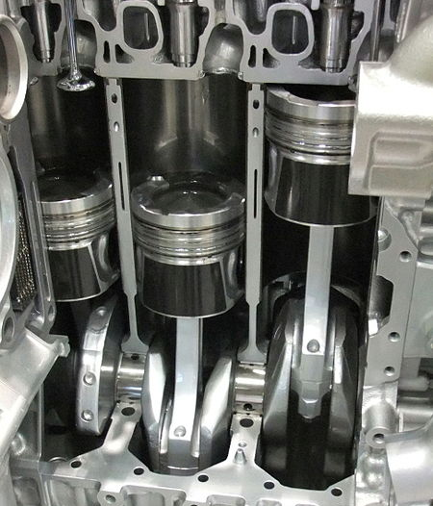

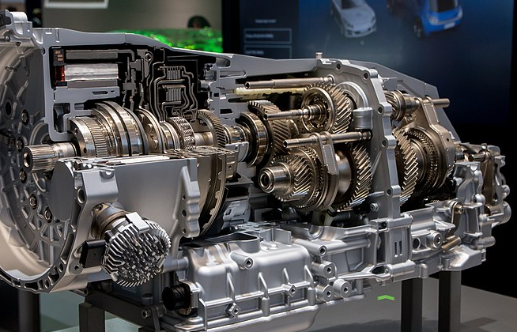
Work, Power, and Energy Transfer
Before we discuss efficiency, we need to discuss the concept of energy transfer.
Energy can’t be created or destroyed (first law of thermodynamics), but many engineering devices convert energy from one form to another. This is an energy transfer.
Image by AleSpa CC-BY-SA 3.0
Image by Johannes Maximilian
CC-BY-SA 4.0
Image by Mj-bird CC-BY-SA 3.0

Slide 3
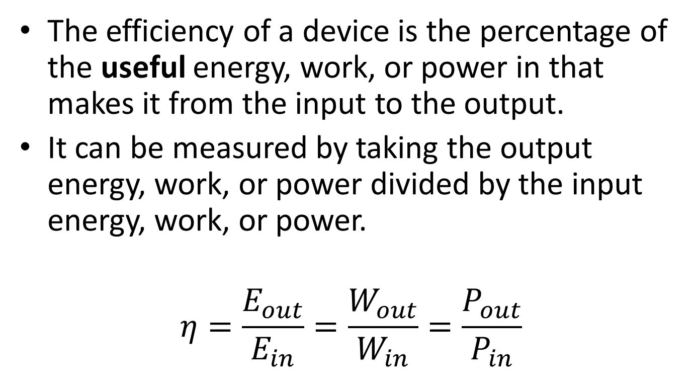
Efficiency
The efficiency of a device is the percentage of the useful energy, work, or power in that makes it from the input to the output.
It can be measured by taking the output energy, work, or power divided by the input energy, work, or power.
$$η=\frac{E_{out}}{E_{in}}=\frac{W_{out}}{W_{in}}=\frac{P_{out}}{P_{in}}$$

Slide 4
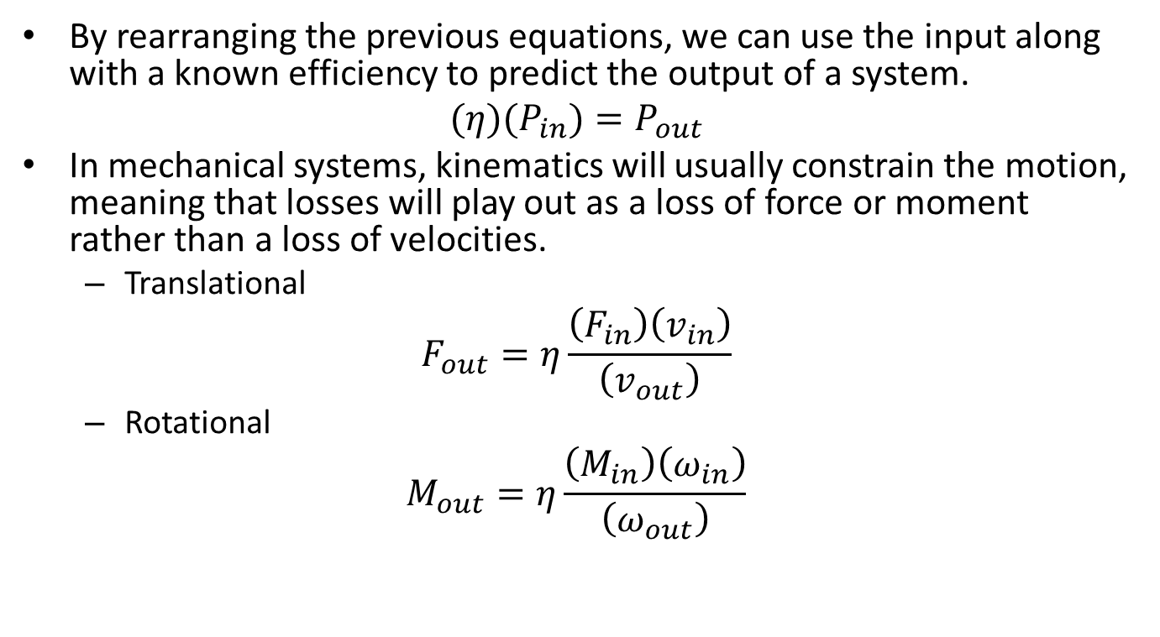
Efficiency
By rearranging the previous equations, we can use the input along with a known efficiency to predict the output of a system.
$$(η)(P_{in})=P_{out}$$
In mechanical systems, kinematics will usually constrain the motion, meaning that losses will play out as a loss of force or moment rather than a loss of velocities.
Translational
$$F_{out}=η\frac{\left(F_{in}\right)\left(v_{in}\right)}{\left(v_{out}\right)}$$
Rotational
$$M_{out}=η\frac{\left(M_{in}\right)\left(ω_{in}\right)}{\left(ω_{out}\right)}$$

Slide 5
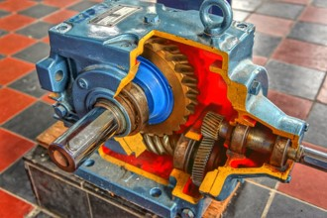
Problems with Inefficiency
Since energy cannot be destroyed, the “lost” energy doesn’t really go away, it is just converted to a non-useful form, such as heat.
In some systems, this built-up heat can further decrease the efficiency, compounding the problem.

Slide 6
Thanks for Watching
See other engineering mechanics videos and access the full tool at…

Slide 7

Worked Example
The input to a gearbox has a measured 32 ft lbs of torque at 700 rpm. The output has 207 ft lbs of torque at 100 rpm.
What is the power input?
What is the power output?
What is the efficiency of the gear train?

Slide 8
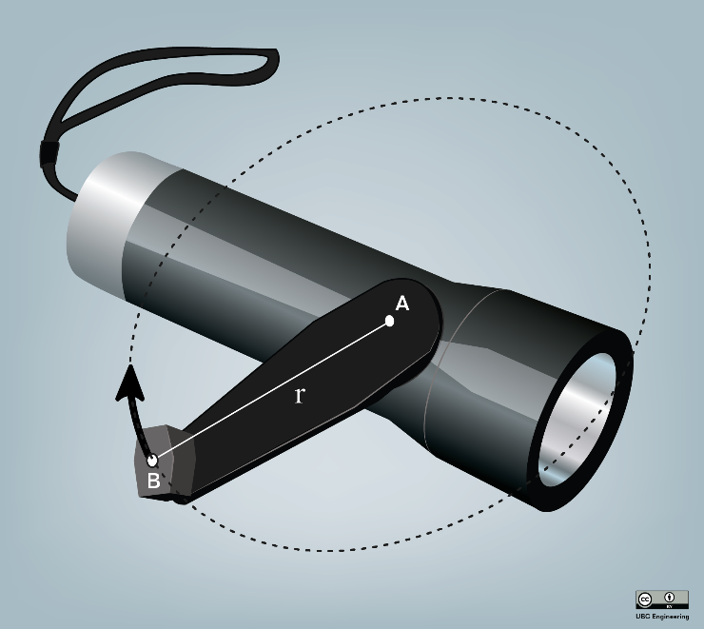
Worked Example
Lucy is playing with a rechargeable flashlight. Spinning the handle generates electrical energy which can be stored to power the three-watt bulb. Lucy rotates the handle with a constant moment of 2 newton meters and an average angular velocity of 3 radians per second for 30 seconds. When she stops turning and switches the flashlight on the bulb stays lit for 1 second. Given this information, how efficient is the flashlight in converting mechanical energy to usable electrical energy?

Slide 9

Worked Example
A race car is traveling along a straight road at a constant speed of 80 kilometers per hour. The engine provides a 50-newton meter torque at each of the back two wheels (radius r = 0.5m). What is the power being applied at the wheels? What is the efficiency of the transmission if the input power from the motor is 17.78 kilowatts?

